Slide 1
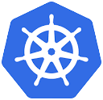
Kubernetes
Kubernetes
A Container Orchestration Tool

Slide 2
Topics ?
• Introduction of Kubernetes
• Features of Kubernetes
• Architecture of Kubernetes
• Nodes in Kubernetes
• PODs in Kubernetes
• Replicas in Kubernetes
• Services in Kubernetes
• Deployment in Kubernetes
• Introduction of Kubernetes
• Features of Kubernetes
• Architecture of Kubernetes
• Nodes in Kubernetes
• PODs in Kubernetes
• Replicas in Kubernetes
• Services in Kubernetes
• Deployment in Kubernetes

Slide 3
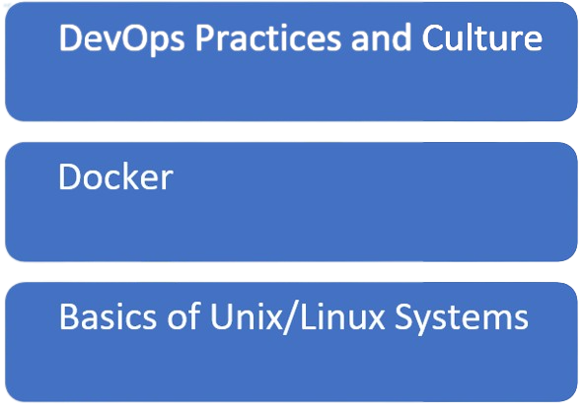
Pre-requisites
Pre-requisites

Slide 4
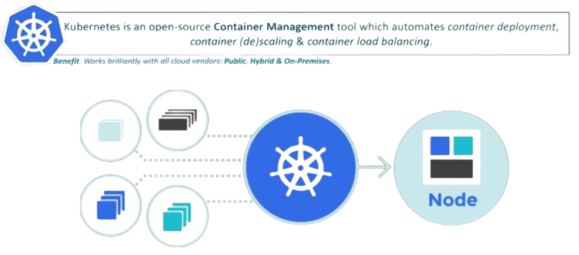
What is Kubernetes ?
.

Slide 5
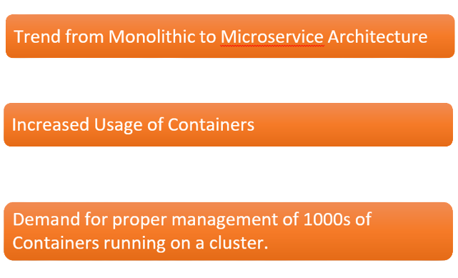
Why Do we need a Container Orchestration Tool?
.

Slide 6
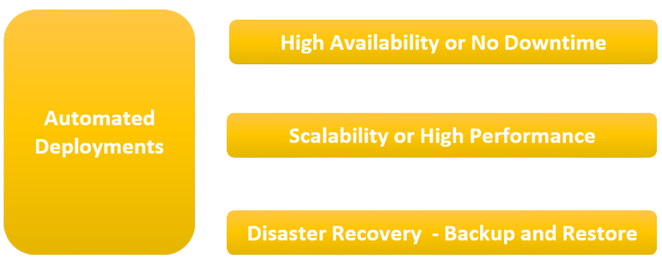
What does a container Orchestration Tool Offers ?
.

Slide 7
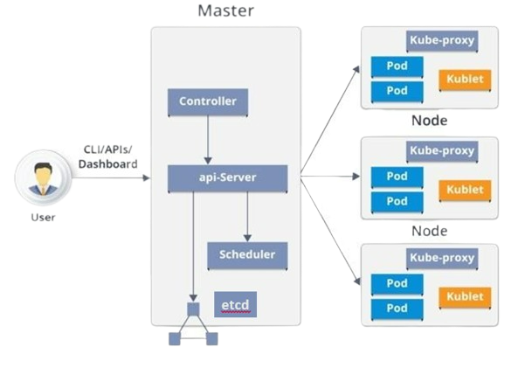
Kubernetes Architecture
Kubernetes has the following main components:
– Master nodes
– Worker nodes
– Distributed key-value store, like etcd.

Slide 8
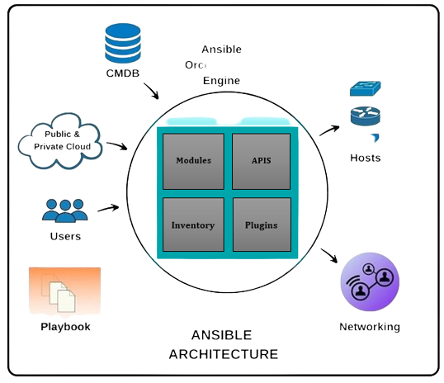
.

Slide 9

What exactly is a playbook ?
Playbooks are the access point to Ansible provisioning.
It’s the Ansible’s way of deploying and configuring different remote servers and environments
It is written in YAML(Yet another Mark-up Language)
On an advanced level playbooks can be used to
Handle multi-tier rollouts
Load balancing tasks for the server.

Slide 10
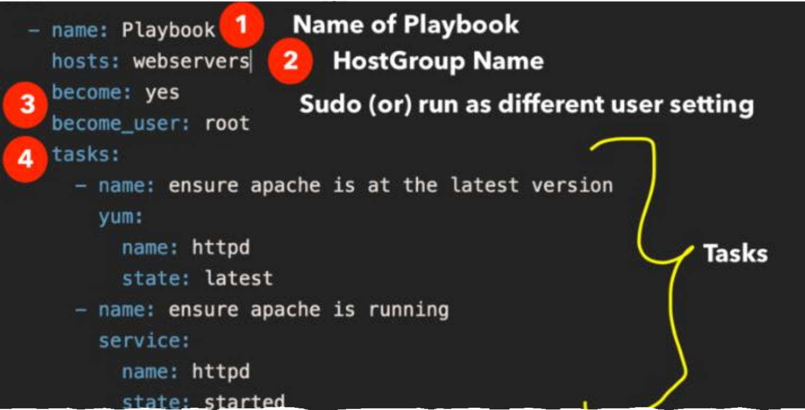
Playbook Structure
.

Slide 11
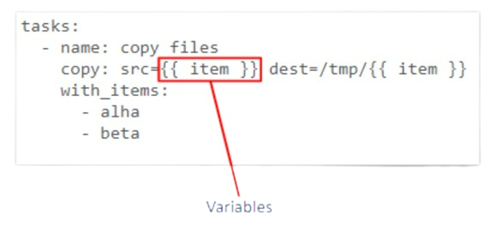
Ansible Playbook: Variables
Variables can be defined and used anywhere in Ansible even in inventory or in an Ad-Hoc Command
Variables extent the functionality of conditionals and loops in Ansible

Slide 12
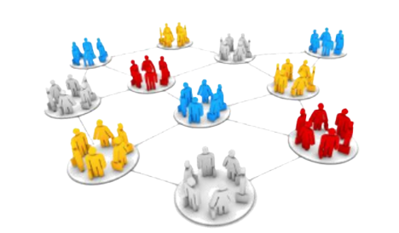
Ansible Roles
Overtime working with Ansible a user may create hundreds of playbooks, variables, templates, defaults etc. Roles allow users to group this logic into an organized manner making reusability and sharing of Ansible structure easier.

Slide 13
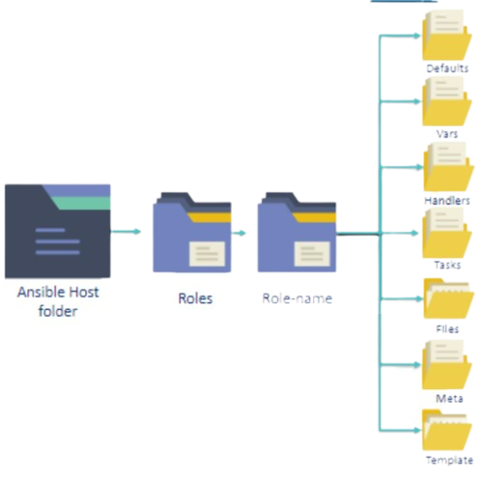
Ansible Roles
Roles uses directories to structure and group all
the playbooks, variables, templates, tasks,
handlers files, and defaults.
This collected logic can be grouped in any way
the user wants, for example you can group
server specific roles together
These roles can then be used inside playbooks
and even as in-line commands.

